Slide 1
Quantum Computing Architectures (EE274) Lecture 24
Hiu-Yung Wong
apr. 26, 2023
hiuyung.wong@sjsu.edu, Office: ENG363
http://www.sjsu.edu/people/hiuyung.wong/index.html

Slide 2
Outline
1-qubit gate and 2-qubit gate
Microwave components

Slide 3
Announcement
Project Part 2 posted

Slide 4
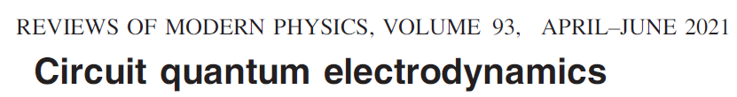

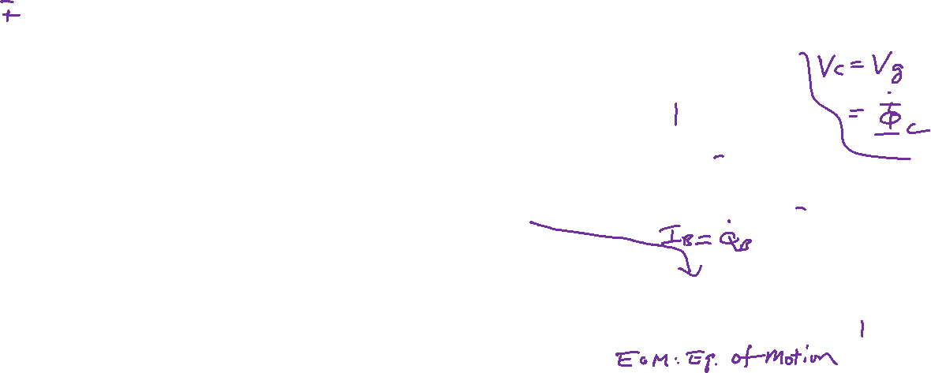
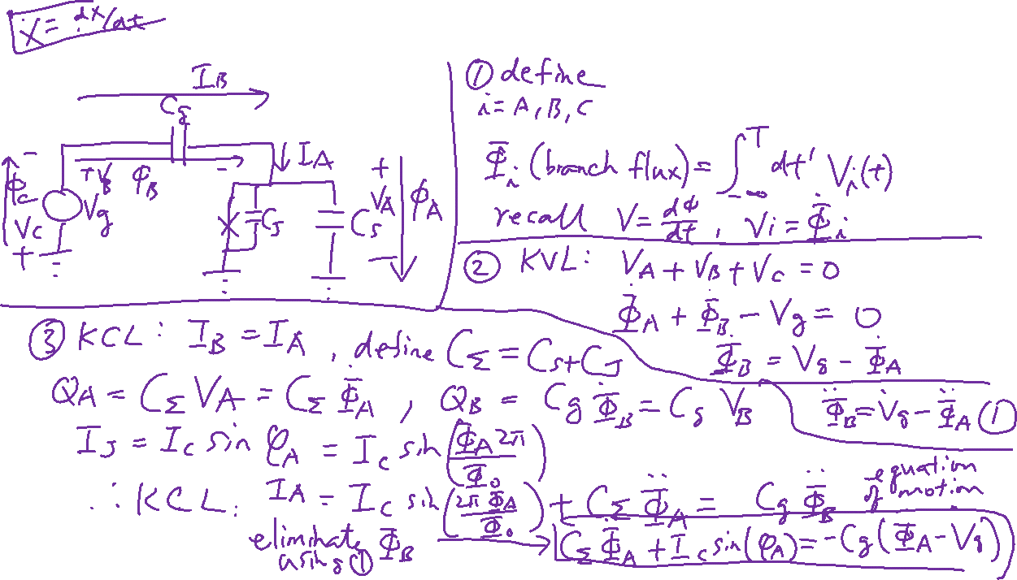
Copper Pair Box – KCL and KVL
Learning outcomes: Understand how to set up KCL and KVL in a quantum circuit

Slide 5
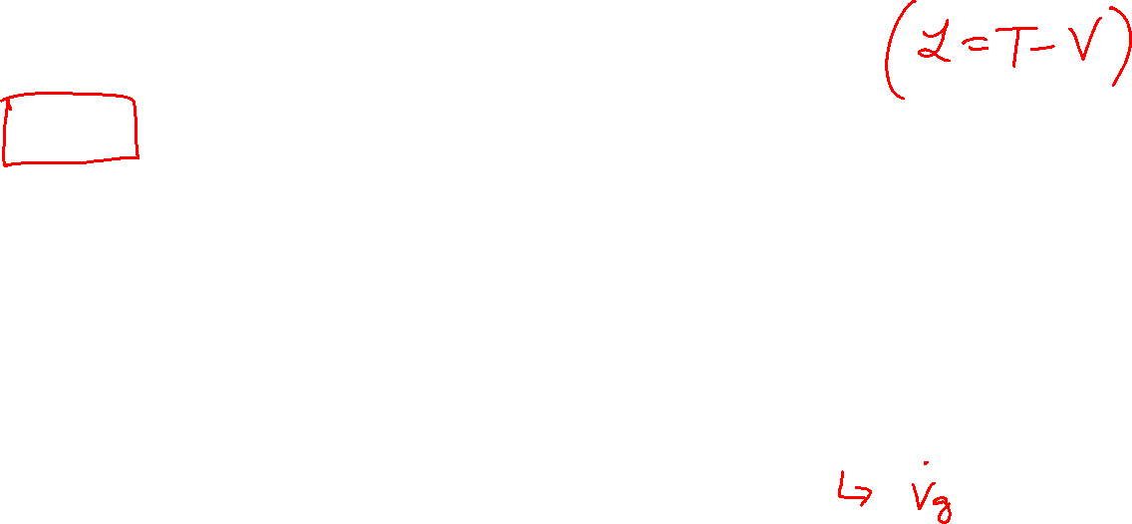
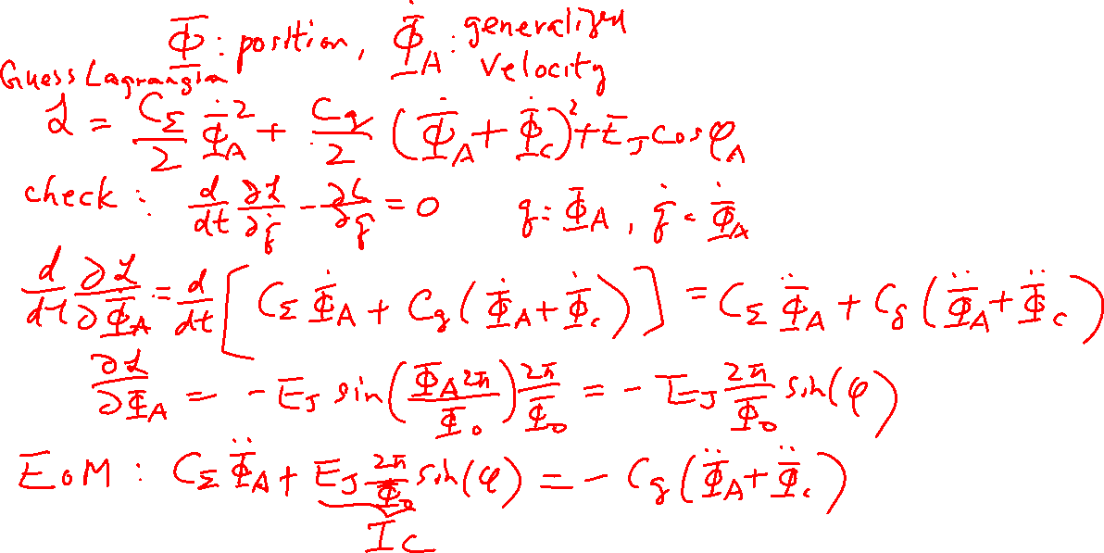
Copper Pair Box– Create Lagrangian
Learning outcomes: Guess the Lagrangian and Check the Lagrangian against the equation of motion

Slide 6
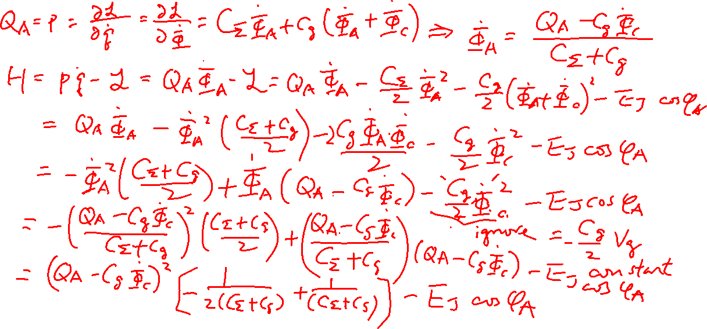
Copper Pair Box– Create Hamiltonian
Learning outcomes: Create the Hamiltonian of the circuit from the Lagrangian

Slide 7

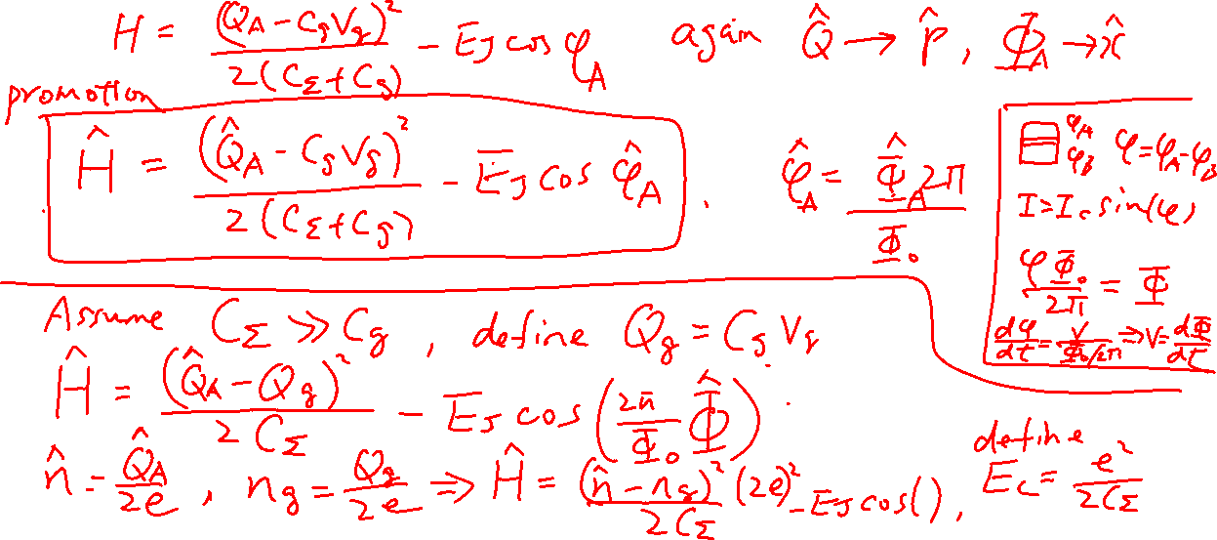
Copper Pair Box– Quantization of the Hamiltonian
Learning outcomes: Quantization of the Hamiltonian

Slide 8
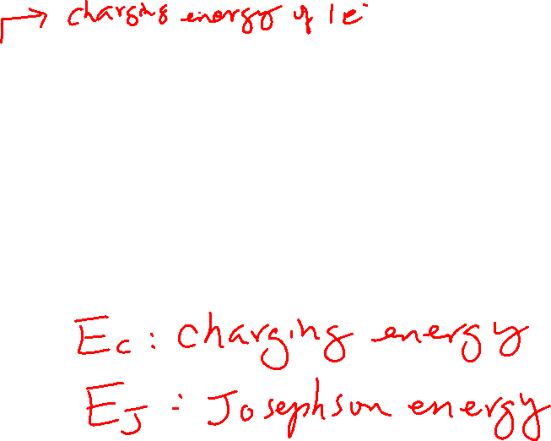
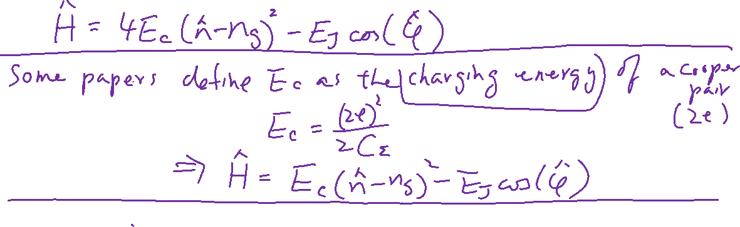
Copper Pair Box– Quantization of the Hamiltonian
Learning outcomes: Quantization of the Hamiltonian

Slide 9
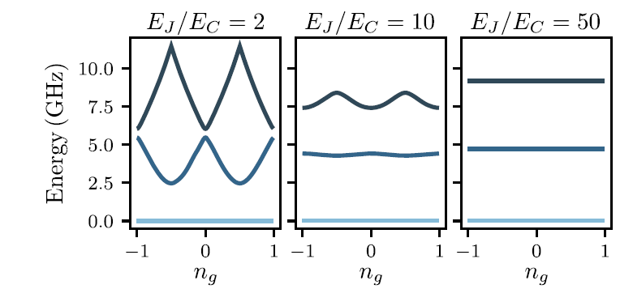




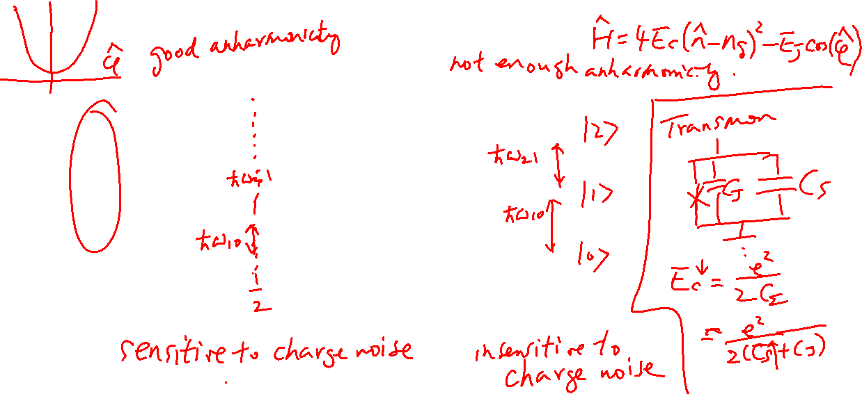
Copper Pair Box – Meaning of the Hamiltonian
Learning outcomes: Understand the Hamiltonian
$$j=2$$
$$j=1$$
$$j=0$$
$$ω_{j}−ω_{0}$$
Charge Qubit
Transmon Qubit

Slide 10

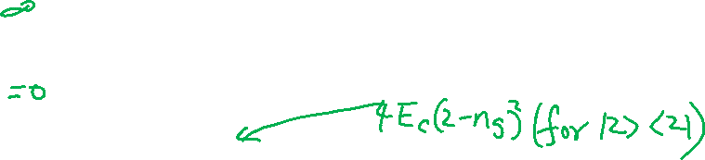
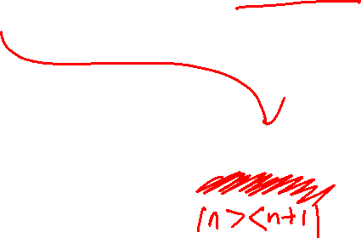
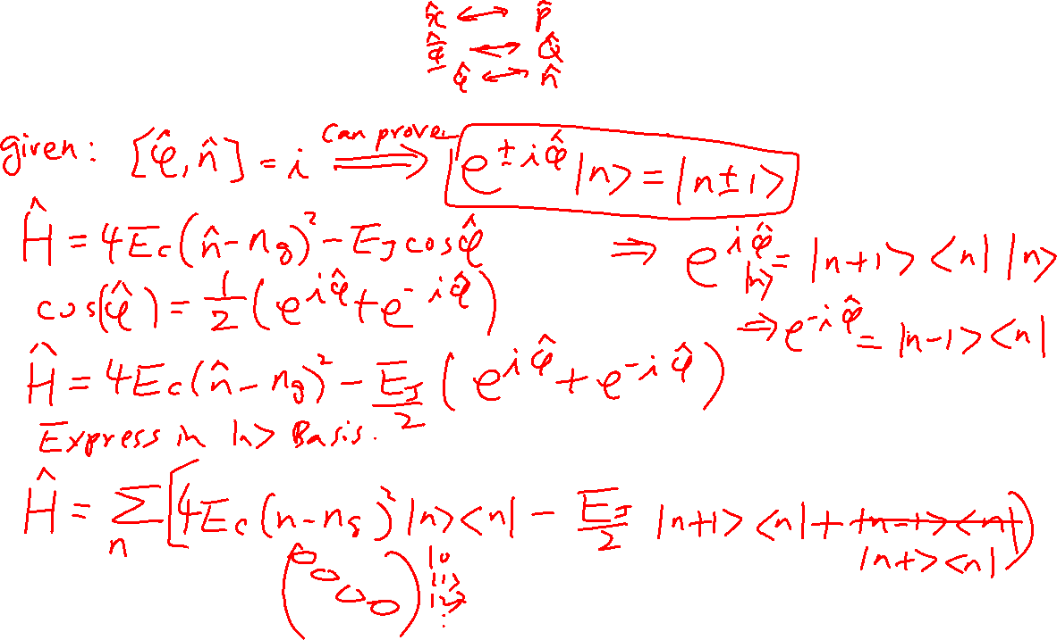
Copper Pair Box – Another form of the Hamiltonian
Learning outcomes: Understand the number operator and phase operator are canonical conjugate to each other

Slide 11
Charge Qubit

Slide 12
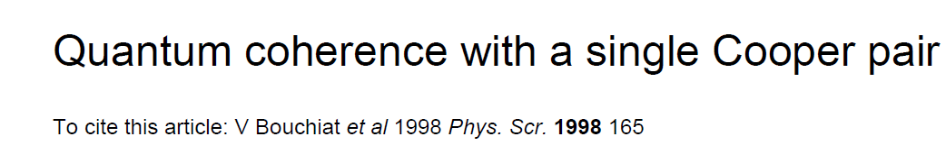
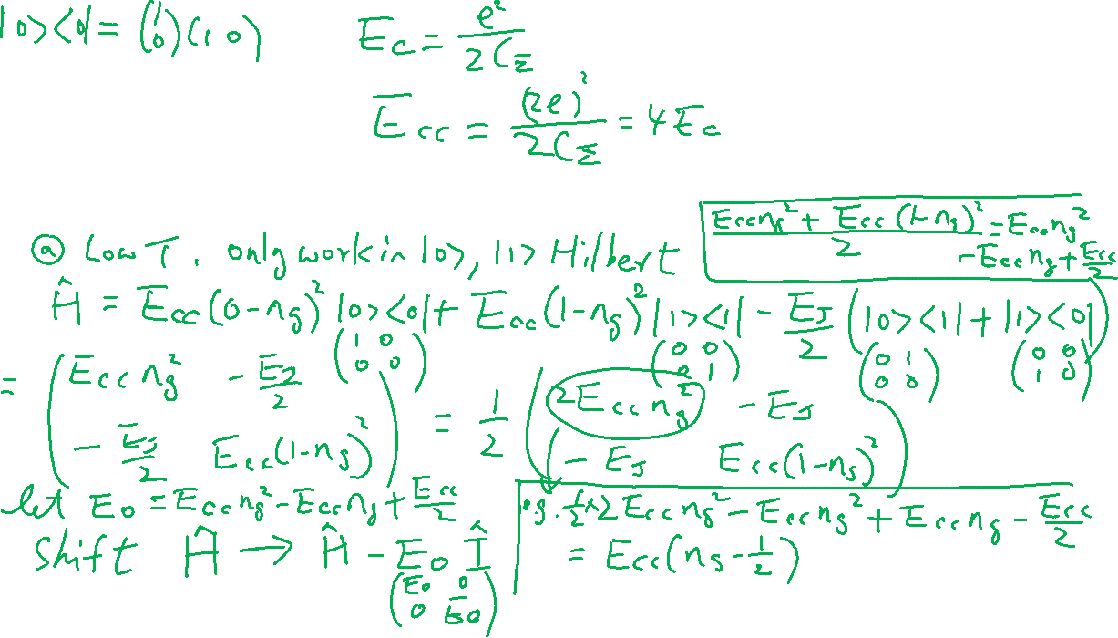
Charge Qubit
Learning outcomes: What is charge qubit? How to simplify the Hamiltonian
In this paper, E_{C} is the charging energy of a cooper pair. I will called E_{cc}, so E_{cc} = 4E_{c} (The E_{c} we derived earlier is the charging energy for an electron)

Slide 13
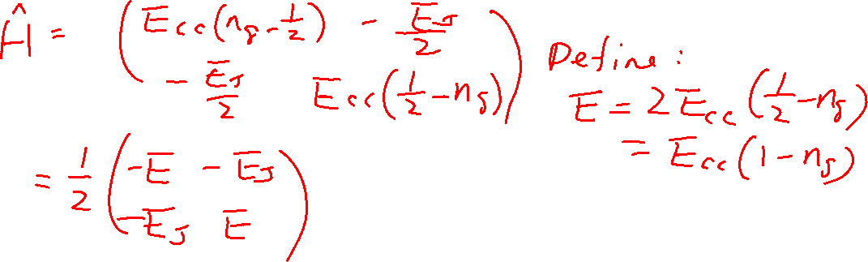
Charge Qubit
Learning outcomes: What is charge qubit? How to simplify the Hamiltonian
In this paper, E_{C} is the charging energy of a cooper pair. I will called E_{cc}, so E_{cc} = 4E_{c} (The E_{c} we derived earlier is the charging energy for an electron)

Slide 14
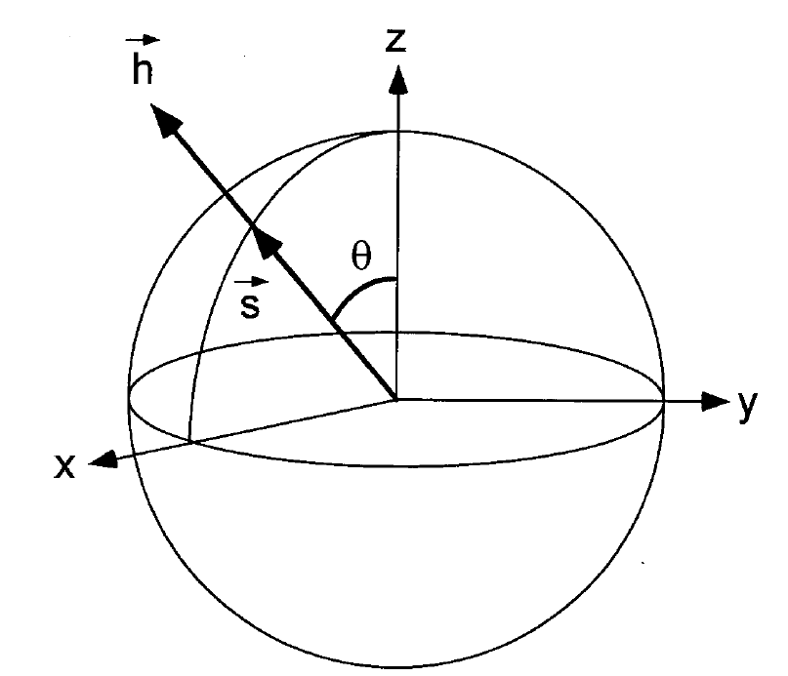
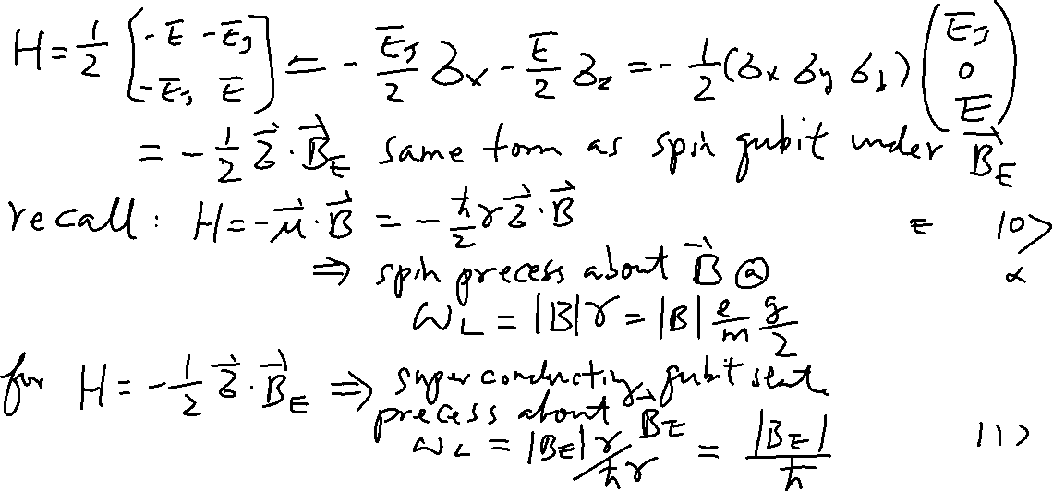

Map to Spin and Bloch Sphere
Learning outcomes: How to map to spin qubit formalism?
$$\vec{B}$$

Slide 15

Diagonalization
Learning outcomes: How to do rotation
$$\vec{B}$$

Slide 16
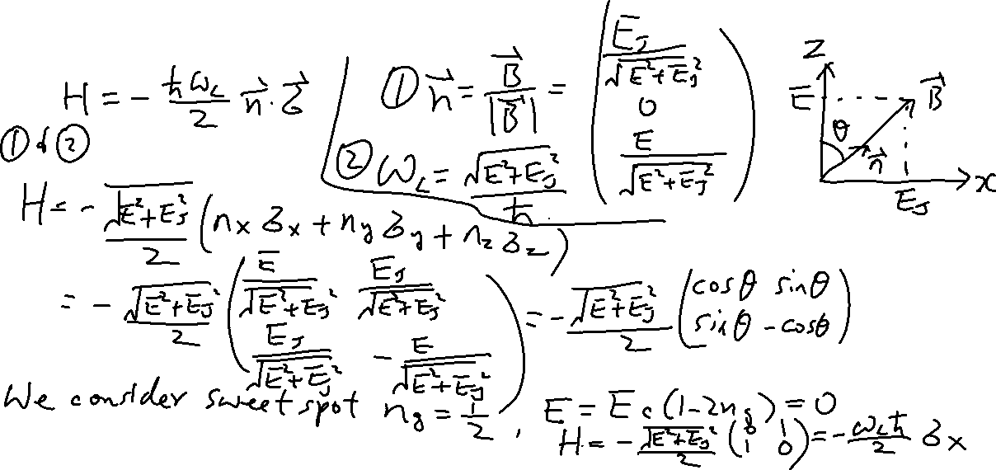
Special case n_{g}=1/2 and Larmor Precession
Learning outcomes: How to see Larmor Precession and Map to Spin Qubits
$$\vec{B}$$

Slide 17
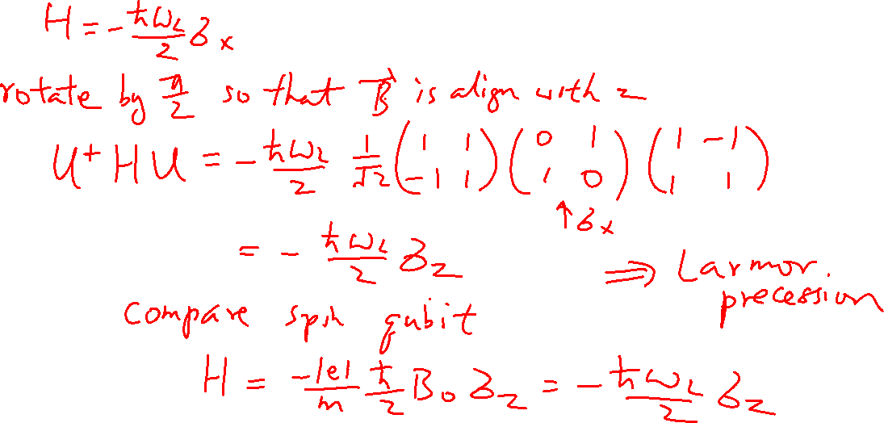

Slide 18
Charge Qubit (Continued)

Slide 19
Charge Qubit
Learning outcomes: What is charge qubit? How to simplify the Hamiltonian
In this paper, E_{C} is the charging energy of a cooper pair. I will called E_{cc}, so E_{cc} = 4E_{c} (The E_{c} we derived earlier is the charging energy for an electron)

Slide 20

Charge Qubit
Learning outcomes: What is charge qubit? How to simplify the Hamiltonian
In this paper, E_{C} is the charging energy of a cooper pair. I will called E_{cc}, so E_{cc} = 4E_{c} (The E_{c} we derived earlier is the charging energy for an electron)

Slide 21
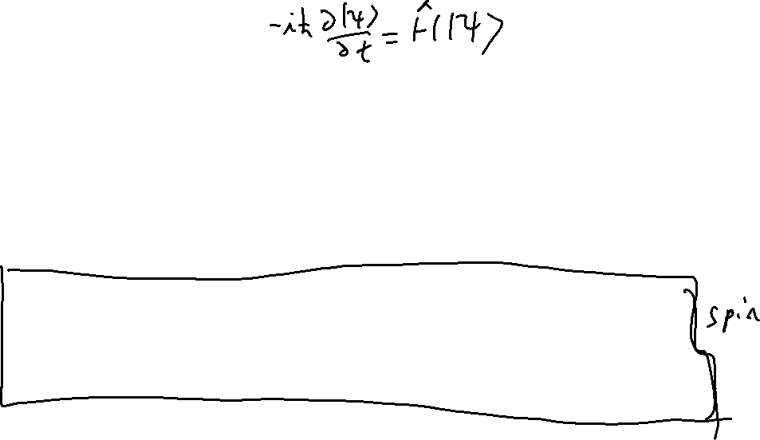
Map to Spin and Bloch Sphere
Learning outcomes: How to map to spin qubit formalism?
$$\vec{B}$$

Slide 22
Diagonalization
Learning outcomes: How to do rotation
$$\vec{B}$$

Slide 23
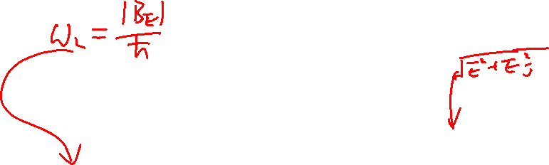
Special case n_{g}=1/2 and Larmor Precession
Learning outcomes: How to see Larmor Precession and Map to Spin Qubits
$$\vec{B}$$

Slide 24
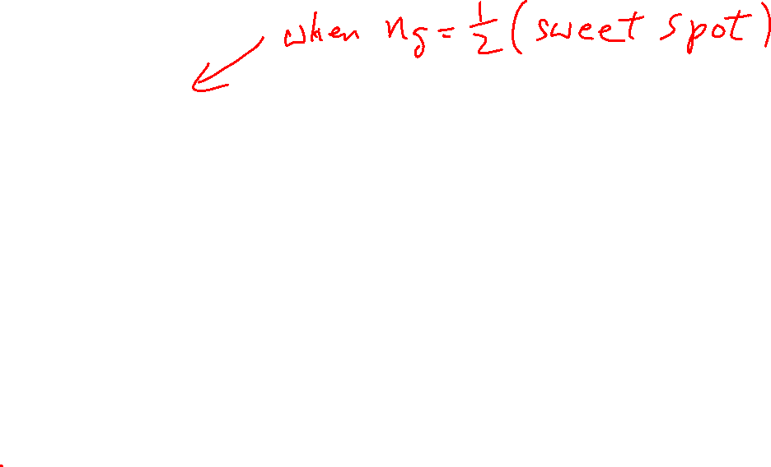

Slide 25
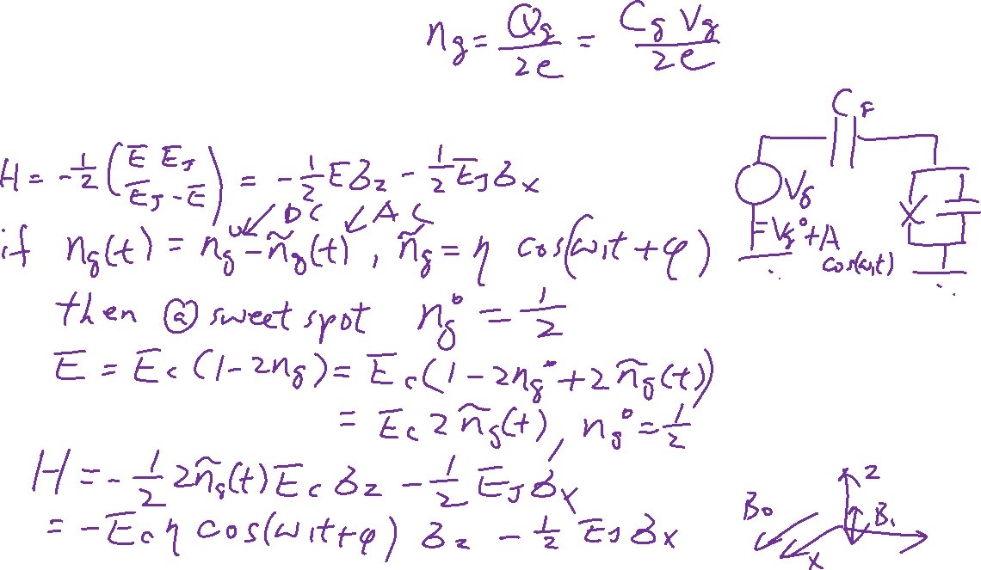
With Driving Pulse
Learning outcomes: Driving Pulse
$$\vec{B}$$

Slide 26
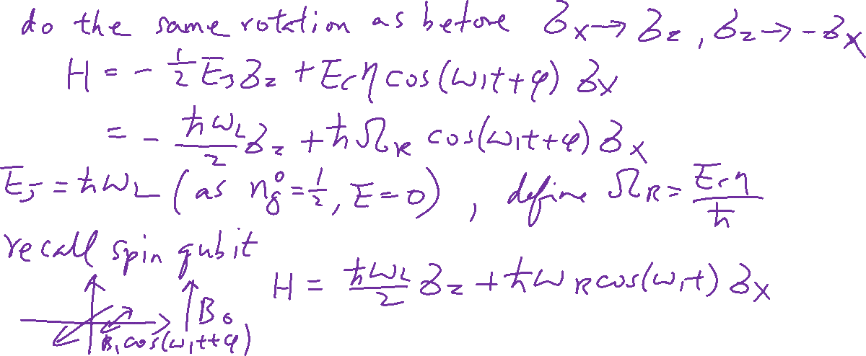
Rabi Oscillation
Learning outcomes: How to relate to oscillating magnetic field

Slide 27
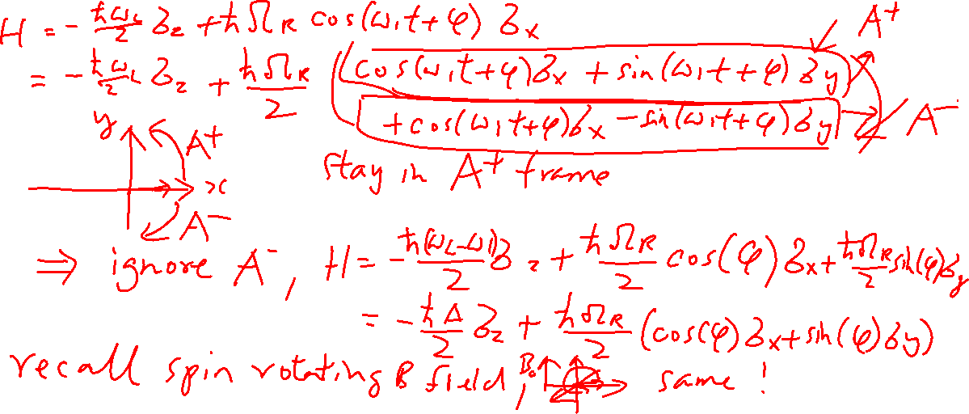
Rotating Frame Approximations
Learning outcomes: Rotating Frame Approximation in CPB

Slide 28
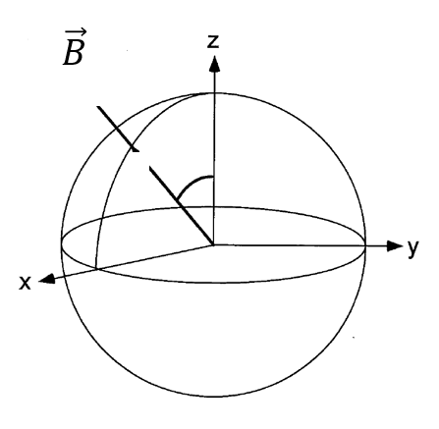
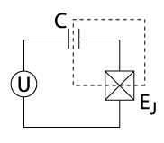
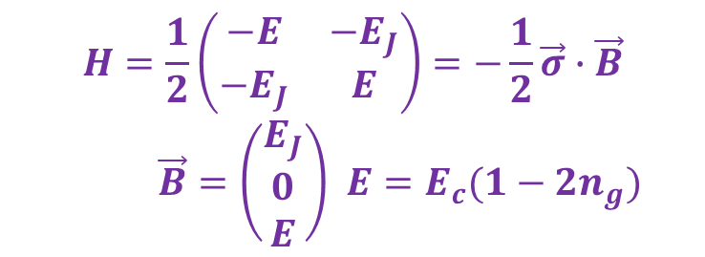




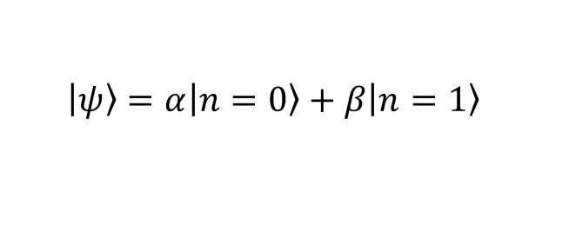

Summary: Implementation of Single Qubit Gates
Superconducting Charge Qubit
$$H=\frac{1}{2}\left(\begin{matrix}−E & −E_{J} \\ −E_{J} & E\end{matrix}\right)=−\frac{1}{2}\vec{σ}∙\vec{B}$$
$\vec{B}=\left(\begin{matrix}E_{J} \\ 0 \\ E\end{matrix}\right)$ ${E=E}_{c}(1−2n_{g})$
$$n$$
Make U time varying so that $n_{g}=\frac{1}{2}−η\cos{(ω_{1}t+φ)}$
Rotating frame approximation (set $ℏ=1$)
$$\left.\left|ψ\right.\right\rangle =α\left.\left|n=0\right.\right\rangle +β\left.\left|n=1\right.\right\rangle$$
$$H=−\frac{Δ}{2}σ_{z}+\frac{Ω}{2}{(\cos\left(φ\right)σ}_{x}+{\sin{(φ)}σ}_{y})$$
Wikipedia
Depends on $ω_{1}$, E_{J} and E_{C}
Phase of the driving pulse
Depends on $η$and E_{C}

Slide 29
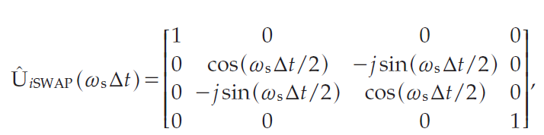
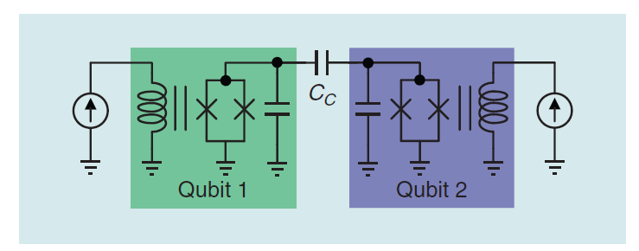
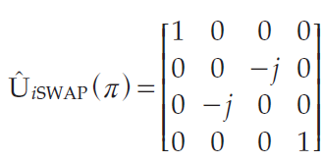
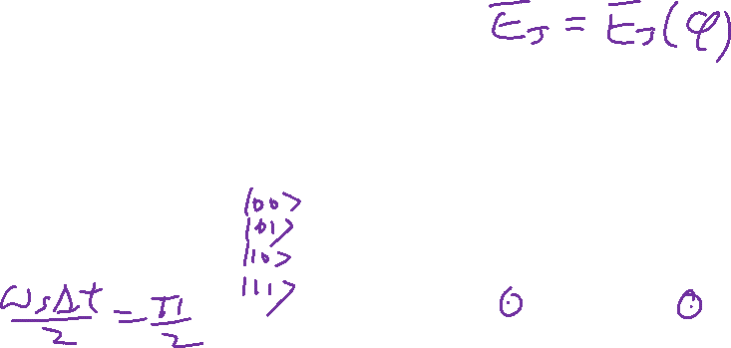
iSWAP Gate – 2-qubit gate
Energy exchange between the two qubit back and fro when they are different.
iSWAP Gate for entanglement operation
J. C. Bardin, D. Sank, O. Naaman and E. Jeffrey, "Quantum Computing: An Introduction for Microwave Engineers," in IEEE Microwave Magazine, vol. 21, no. 8, pp. 24-44, Aug. 2020.

